Slide 1
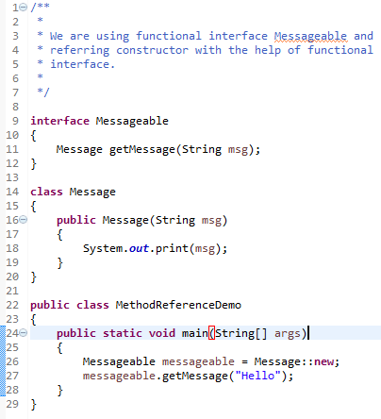
Reference to a Constructor
Referring
We can refer a constructor by using the new keyword. Here, we are referring constructor with the help of functional interface.
Syntax : ClassName::new

